Slide 1
Java
“Most popular” language
Runs on a “virtual machine” (JVM)
More complex than some (eg. Python)
Simpler than others (eg. C++)

Slide 2
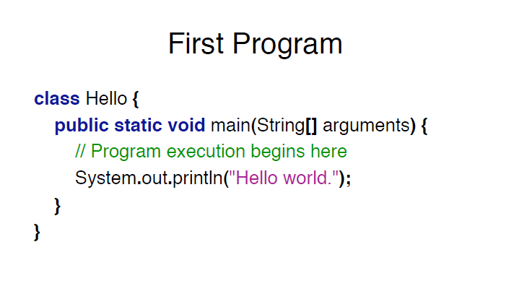

Slide 3
Program Structure
class CLASSNAME
{
public static void main(String[] arguments)
{STATEMENTS}
}

Slide 4
Program Structure
class CLASSNAME
{
public static void main(String[] arguments)
{STATEMENTS}
}

Slide 5
Output
System.out.println(some String) outputs to the console
Example:System.out.println(“output”);

Slide 6
Types
Kinds of values that can be stored and manipulated.
boolean: Truth value (true or false).
int: Integer (0, 1, -47).
double: Real number (3.14, 1.0, -2.1).
String: Text (“hello”, “example”).

Slide 7
Variables
Named location that stores a value of one particular type.
Form: TYPE NAME;
Example:String foo;
Example: int i;

Slide 8
Assignment =
Use = to give variables a value.
Example:
String foo;
foo = “IAP 6.092”;
Example: int i;
i = 10;

Slide 9
Assignment
Assignment can be combined with a variable declaration.
Example:double badPi = 3.14;
boolean isJanuary = true;

Slide 10
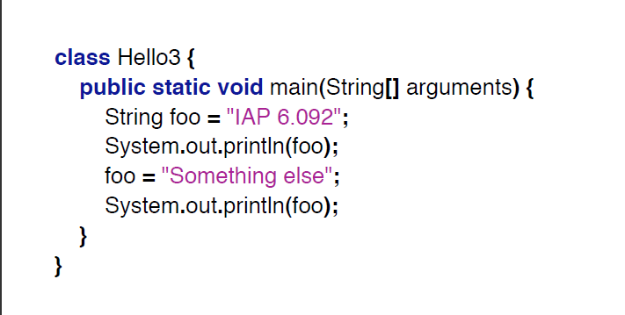

Slide 11
Operators
Symbols that perform simple computations
Assignment: =
Addition: +
Subtraction: -
Multiplication: *
Division: /

Slide 12
Order of Operations
Follows standard math rules:
Parentheses
Multiplication and division
Addition and subtraction

Slide 13
class DoMath
{
public static void main(String[] arguments)
{
double score = 1.0 + 2.0 * 3.0;
System.out.println(score);
score = score / 2.0;
System.out.println(score);
}
}

Slide 14
class DoMath2 {
public static void main(String[] arguments)
{
double score = 1.0 + 2.0 * 3.0;
System.out.println(score);
double copy = score;
copy = copy / 2.0;
System.out.println(copy);
System.out.println(score);
}
}

Slide 15
String Concatenation (+)
String text = "hello" + " world";
text = text + " number " + 5;
// text = "hello world number 5"

Slide 16
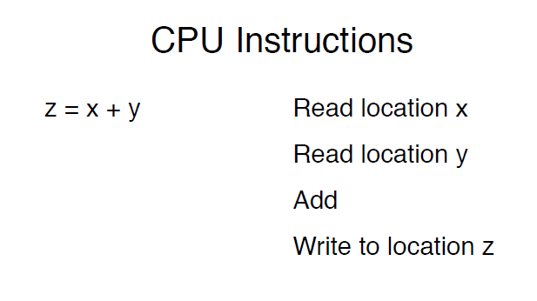

Slide 17
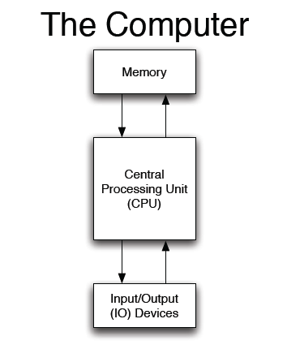

Slide 18
Programming Languages
Easier to understand than CPU instructions
Needs to be translated for the CPU to understand it

Slide 19
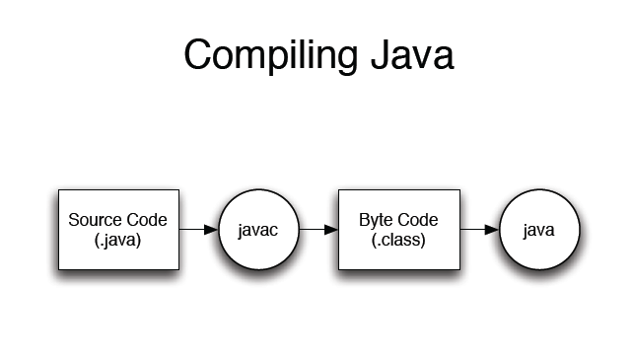

Slide 20
Create a new class called GravityCalculator
Copy and paste the following initial version:
class GravityCalculator
{
public static void main(String[] arguments)
{
double gravity =-9.81; // Earth's gravity in m/s^2
double initialVelocity = 0.0;
double fallingTime = 10.0;
double initialPosition = 0.0;
double finalPosition = 0.0;
System.out.println("The object's position after " + fallingTime +
" seconds is " + finalPosition + " m.");
}
}
Run it in Eclipse (Run → Run As → Java Application).

